Slide 1




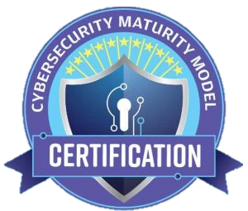


CMMC is Here
A Lead CCA’s Breakdown of How to Prepare for a Level 2 Assessment
Notes:
“Proprietary and Confidential?”

Slide 2

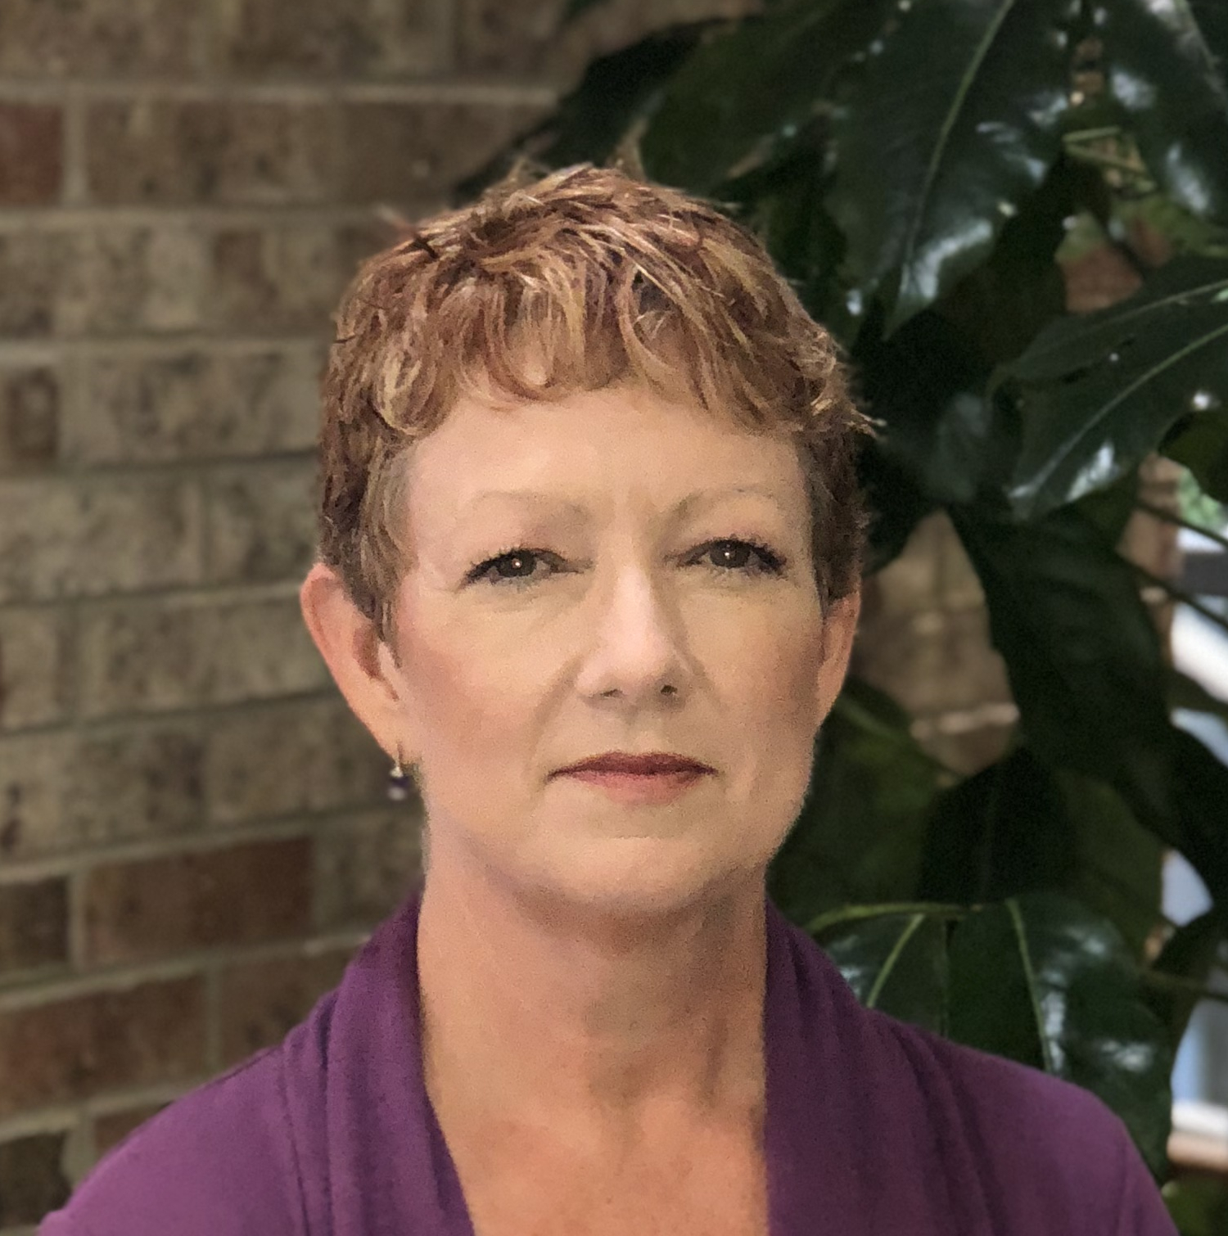

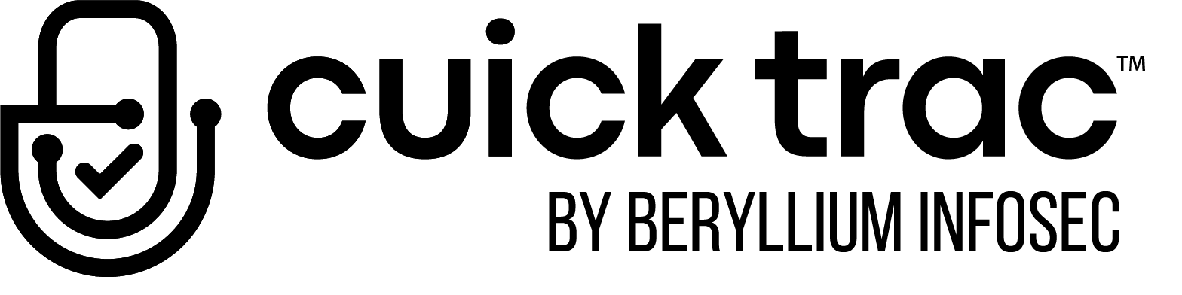

Panelists
Derek White | Chief Operating Officer & Co-Founder
When Beryllium InfoSec was founded in 2018, Derek White and his team set out to help the Defense Supply Chain overcome resource constraints with practical, affordable cybersecurity solutions. Beryllium’s core product offering, the Cuick Trac Managed Enclave, solves that problem. Building on that mission, Derek brings deep expertise in CUI programs and compliance, guiding contractors through NIST SP 800-171, DFARS, and CMMC requirements. Together, they drive outcomes that make security achievable and sustainable across the Defense Industrial Base.
Glenda Snodgrass | President and Lead CCA
Glenda R. Snodgrass is a Certified Information Security Manager (CISM), CMMC Certified Professional (CCP), CMMC Certified Assessor (CCA), Lead CCA and ITAR Export Control Professional (ECoP®), specializing in helping organizations meet their security and compliance requirements. She has conducted numerous workshops covering GLBA, PCI DSS, HIPAA, FAR 52.204-21, DFARS 252.204-7012, NIST 800-171, NIST CSF and the Cyber Security Model Certification (CMMC). Her dynamic personality and effective teaching style have made her a sought-after public speaker and corporate trainer for more than twenty years.

Slide 3

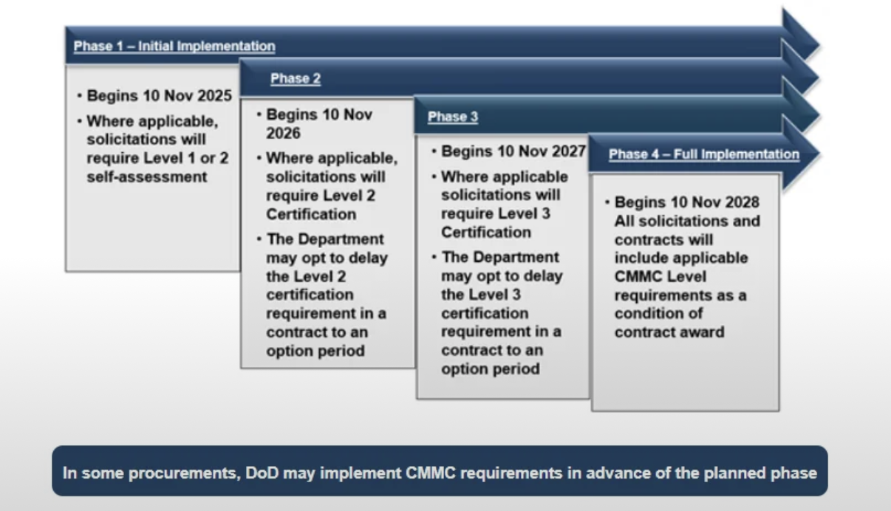
Current CMMC Timeline
Recap: Phase-IN Implementation Plan
Finally here!
Important to note:
“Self-Assessment” vs C3PAO

Slide 4
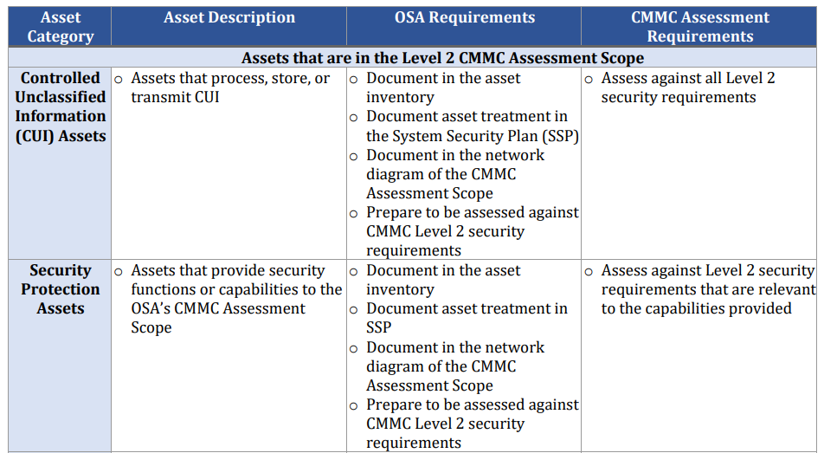
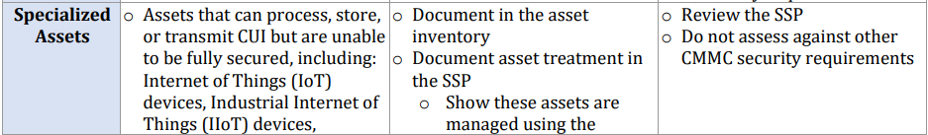
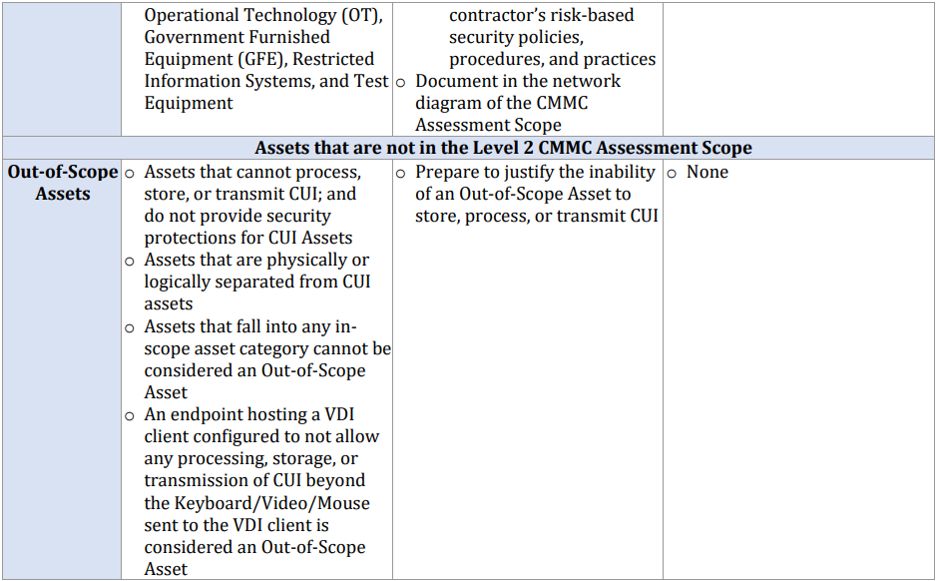
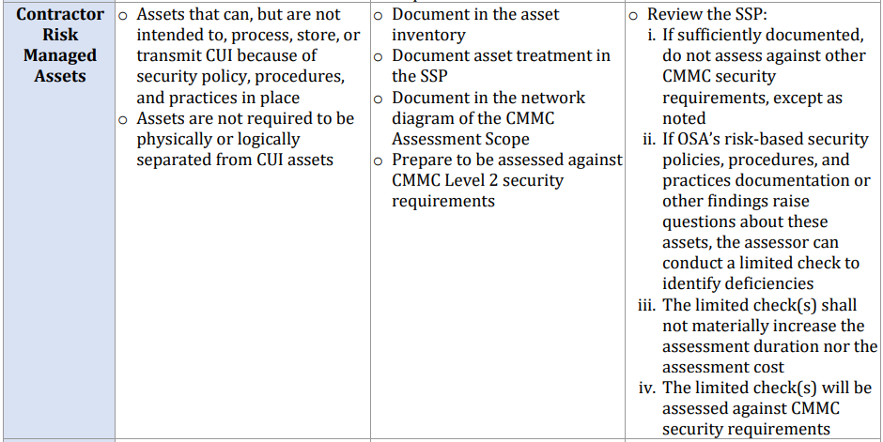
Avoid Common Pitfalls
Proper Scoping
Asset Categories
Separation Techniques
External Service Providers (ESPs)
Bring Your Own Device (BYOD)

Slide 5
Avoid Common Pitfalls
Proper Scoping
Good Documentation
Asset Categories
Complete
Separation Techniques
Accurate (Say what you do, do what you say)
External Service Providers (ESPs)
Current
Bring Your Own Device (BYOD)

Slide 6
Avoid Common Pitfalls
Proper Scoping
Good Documentation
Understanding POAMs
Asset Categories
Complete
Not fully or successfully implemented
Separation Techniques
Accurate (Say what you do, do what you say)
Don't plan to begin an
assessment with open POAMs
External Service Providers (ESPs)
Current
Know which controls are POAMable
Bring Your Own Device (BYOD)
Only 22 max
Only 1-pointers
No L1 controls
180 days to close out

Slide 7
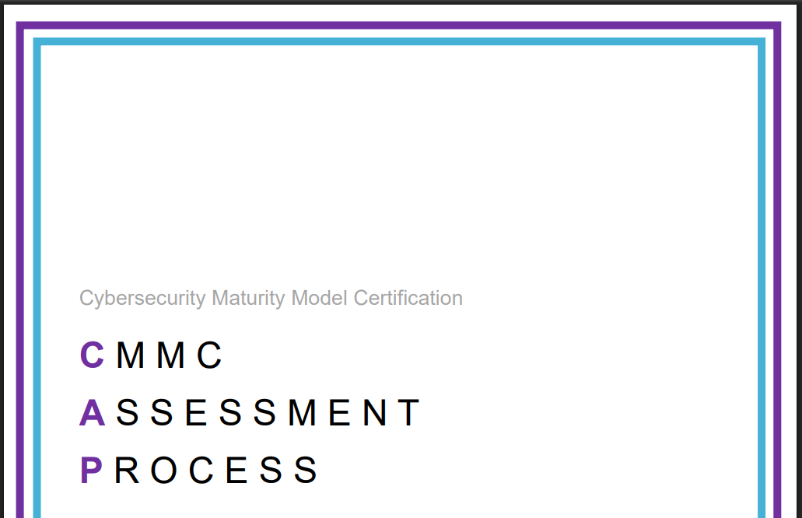
Understand the CMMC Assessment Process
Read the CMMC Assessment Process
(CAP)
Have your people ready for interviews
Prepare common tests
PRACTICE!
https://cyberab.org/Portals/0/CMMC%20Assessment%20Process%20v2.0.pdf

Slide 8
Understand the CMMC Assessment Process
Know the controls by AO and know the rule
Be prepared to argue & have authoritative references ready
Work off the most current version of the documentation.
NIST SP 800171 r2 not r3, v2.13 of AGs and SGs - Official versions at https://dodcio.defense.gov/cmmc/Resources-Documentation/

Slide 9
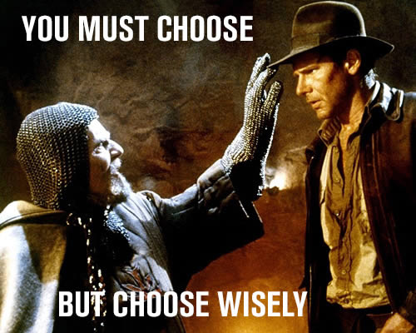
Shop Around and Choose Wisely
CCAs have widely divergent opinions on many topics
C3PAOs vary widely in experience and skill set
Read what they write & watch their videos
Cooey Wiki | Identifying a Certified Third Party Assessing Organization (C3PAO)
Good Resources!
National Defense – ISAC | C3PAO Shopping Guide for Small & Medium-Sized Businesses

Slide 10
Questions?
CMMC is Here
A Lead CCA’s Breakdown of How to Prepare for a Level 2 Assessment
Want to discuss in more detail?
info@berylliuminfosec.com | cmmc.info@ati.org

