Slide 1




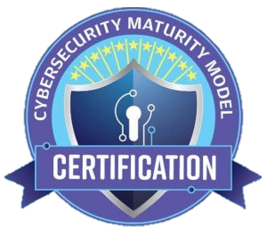


CMMC is Here
Pursing CUI Contracts For The First Time
Notes:
“Proprietary and Confidential?”

Slide 2



Panelists

Slide 3
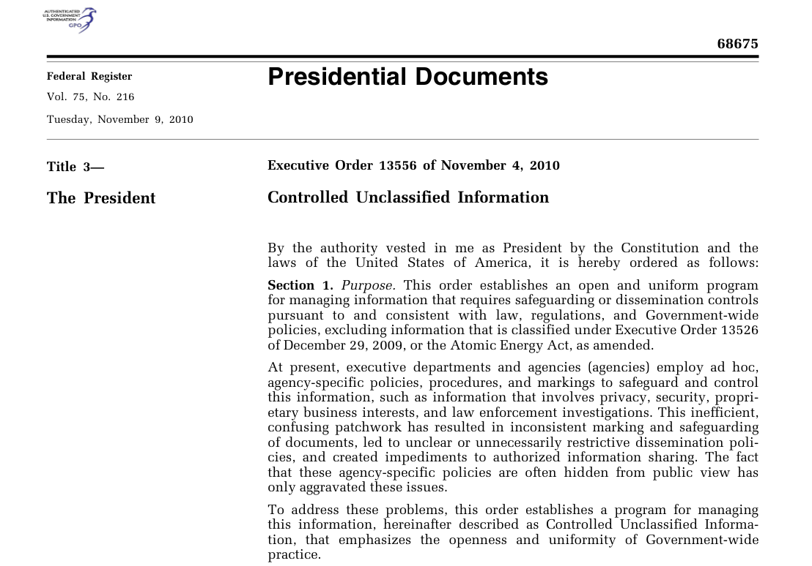
What is CUI?
Controlled Unclassified Information (CUI) is information that requires safeguarding or dissemination controls pursuant to and consistent with applicable law, regulations, and government-wide policies but is not classified under Executive Order 13526 or the Atomic Energy Act, as amended.
CUI Program established by Executive Order 13556 in November 2010

Slide 4
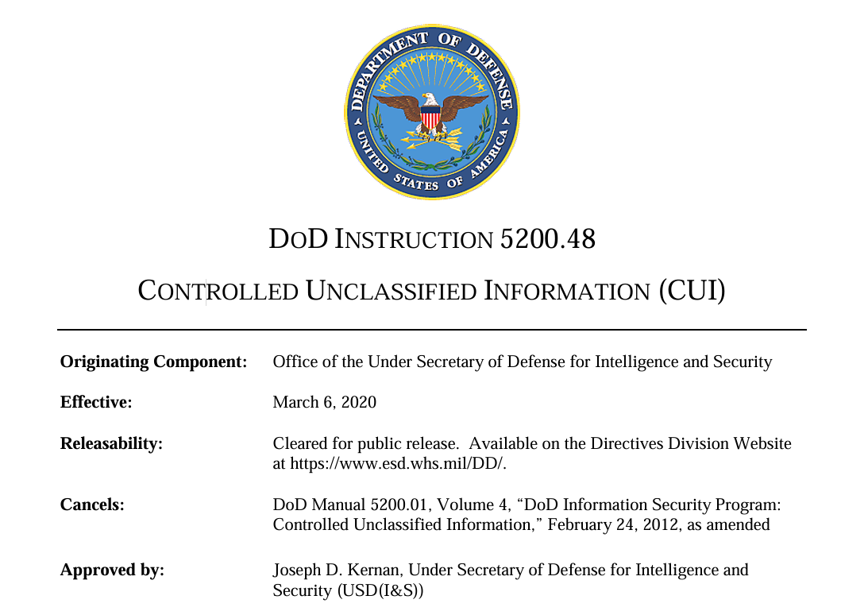
CUI in the DoW
Controlled Unclassified Information (CUI) is sensitive information that does not meet the criteria for classification but must still be protected. It is Government-created or owned UNCLASSIFIED information that allows for, or requires, safeguarding and dissemination controls in accordance with laws, regulations, or Government-wide policies.
DoD Instruction 5200.48 established the DoD CUI program in March 2020.
Resources available at https://www.dodcui.mil/

Slide 5
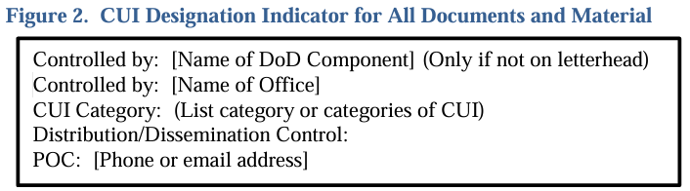
How To Identify CUI
Documents must be marked, at a minimum with “CUI” in the banner and footer of the document.
Portion markings may also be included to identify individual sections, parts, paragraphs, etc. with either (U) or (CUI) as applicable.
The first page of the document or material including CUI will include a CUI designation indicator.

Slide 6
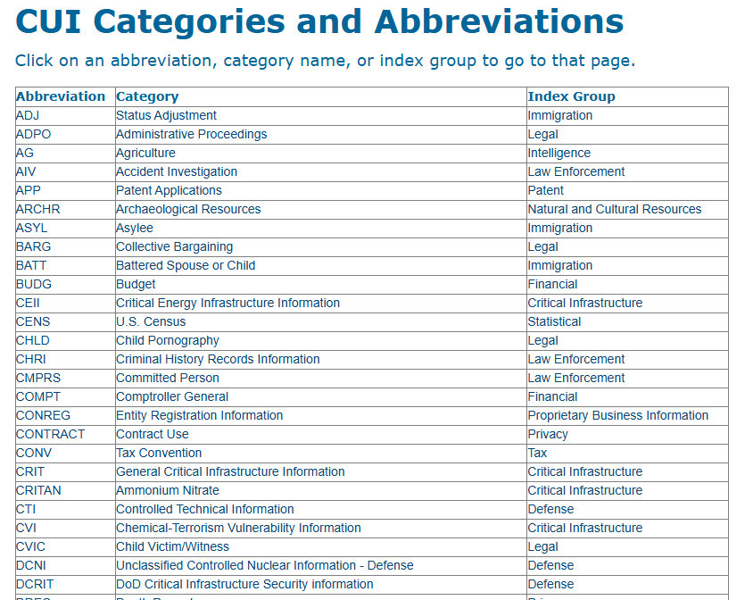
CUI Categories
CUI Markings should also include the abbreviation for the applicable category of CUI. Categories and their abbreviations can be found at https://www.dodcui.mil/CUI-Categories-and-Abbreviations/

Slide 7
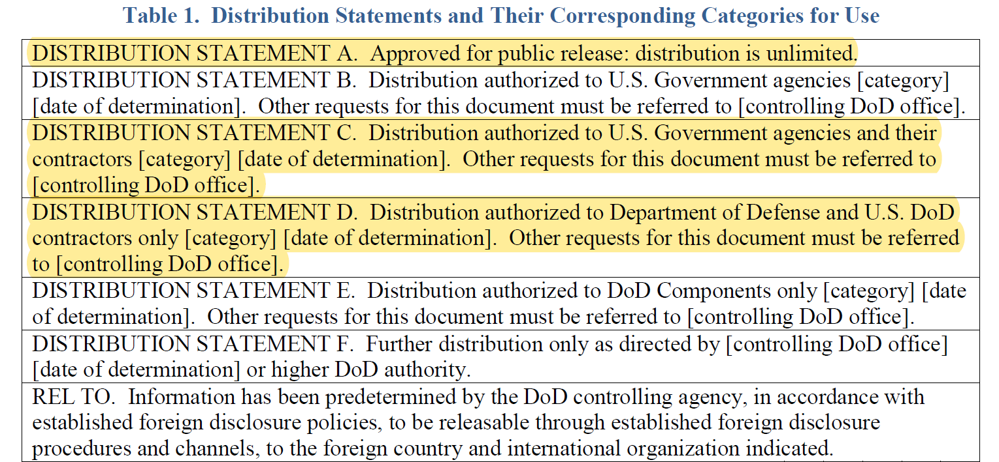
Distribution/Dissemination Controls
DoD Instruction 5230.24 established distribution statements for DoD Technical Information.

Slide 8

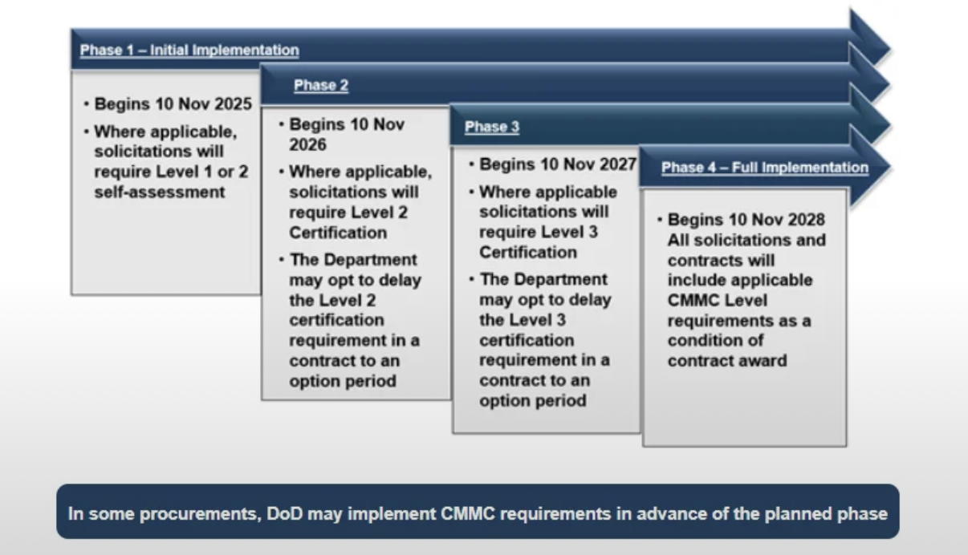
Current CMMC Timeline
Recap: Phase-IN Implementation Plan
We are here!
Important to note:
“Self-Assessment” vs C3PAO

Slide 9
DFARS 252.204-7012
Safeguarding Covered Defense Information and Cyber Incident Reporting
Formally implemented in 2015 to increase cyber security of CUI throughout Defense Industrial Base
Requires rapid reporting of cyber incidents
Requires compliance with NIST 800-171 requirements (110 total)
Mandatory flow down to subcontractors “for operationally critical support, or for which subcontract performance will involve covered defense information”
Self-attestation era
Still in use today

Slide 10
DFARS 252.204-7021
Contractor Compliance With the Cybersecurity Maturity Model Certification Level Requirements
Late 2025, integrating the CMMC Program into defense contracts
Moves into the assessment/certification era
Same 110 security controls of NIST 800-171
Requires given CMMC level to be achieved prior to award
Requires active CMMC cert and annual attestations in SPRS
Requires contractor to update government Contracting Officer with CMMC UIDs changes throughout contract performance
Requires very specific subcontract management
Mandatory flowdown in subcontracts that “will contain a requirement to process, store, or transmit FCI or CUI”

Slide 11
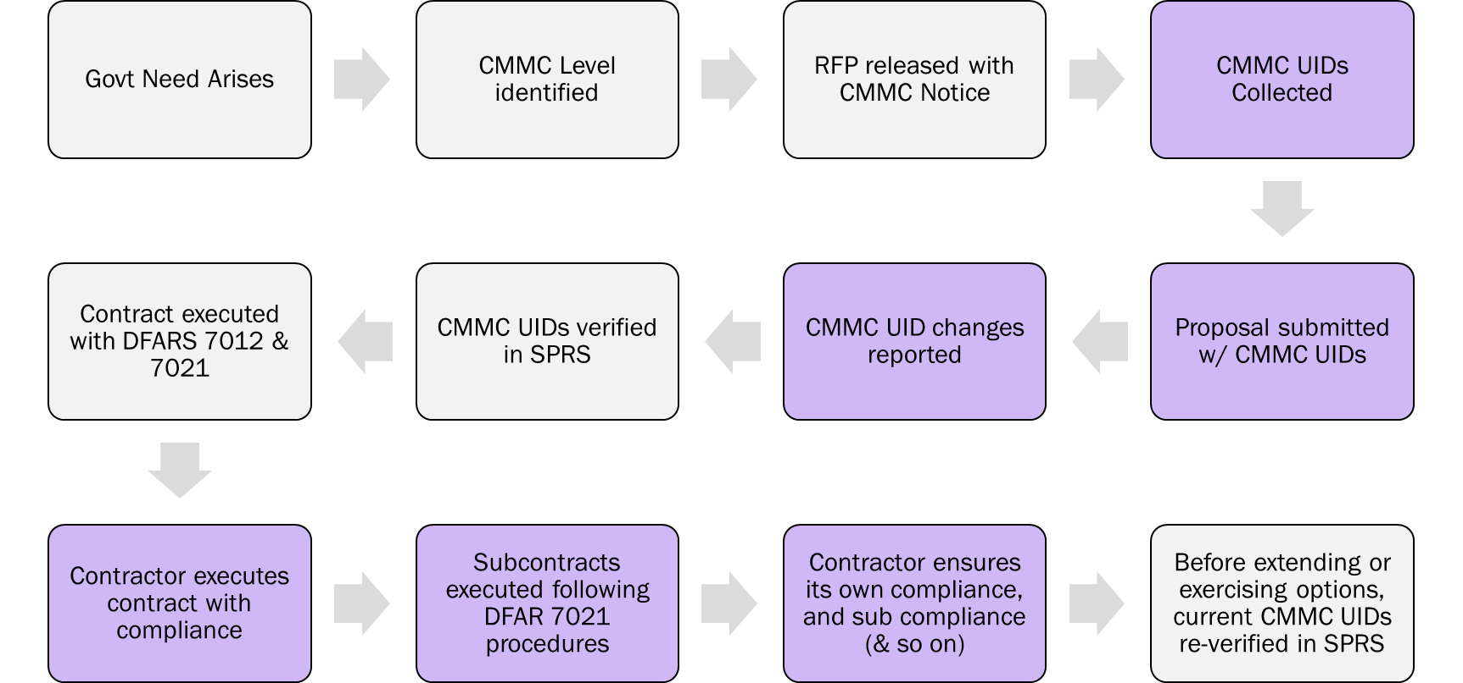
DFARS Subpart 204.75

Slide 12
What Subs Can Expect
If you are not expecting to handle CUI on a subcontract, you may still have the CMMC clause flowed down to you in that subcontract, requiring Level 1 rather than Level 2
CMMC applicability and required levels will vary subcontract to subcontract
Different primes will manage things differently
Primes will start identifying CMMC Level requirements in your RFPs
Last minute surprises may happen

Slide 13
What Subs Can Expect
Since industry can’t verify other contractors through SPRS, government expects industry to share documentation with each other
Primes will likely ask for a copy of your SPRS record with visibility of your CMMC UID and associated dates throughout the lifecycle
Likely have to report CMMC UID changes used on the subcontract to your prime

Slide 14
Potential Points of Confusion
DFARS 7021 is not replacing 7012
If sub isn’t going to handle CUI, then no need to flowdown 7021 Level 2
Acronyms outside of the CMMC realm:
  UID = Connects to one CMMC certification [SPRS]
  UEI = Connects to one business entity [SAM.gov]
  IUID = Connects to one tangible asset/deliverable [ctr generated]
CMMC UID numbers will change frequently
CMMC UID reporting of changes versus additions

Slide 15
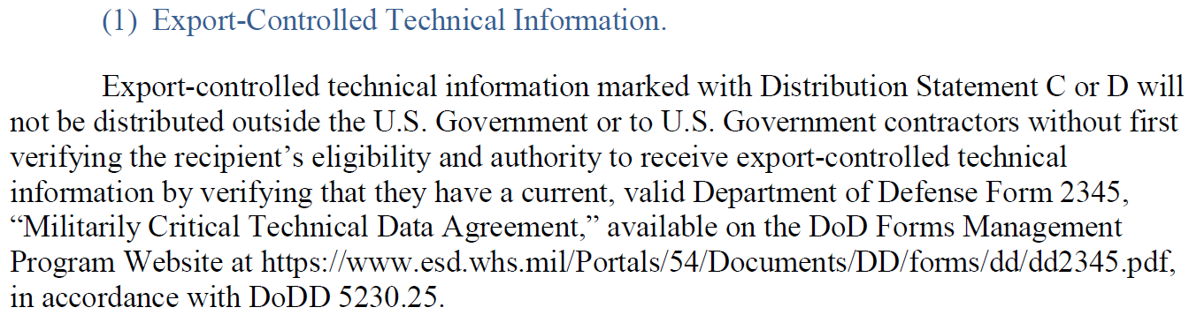
How To Share CUI Properly
Ensure the recipient meets all requirements identified in the distribution and dissemination controls and the applicable instructions.
  If CMMC is included in the contract/agreement, then the recipient must also have the appropriate CMMC status.
When sending CUI, send via properly encrypted means in accordance with NIST SP 800-171
DD Form 2345 is required for Distribution C and D information (DoDI 5230.24)

Slide 16
Purpose of DD Form 2345
Military Critical Technical Data Agreement
Certification is required per DoDD 5230.25 if you need to handle/access DoW unclassified export controlled technical information for the following purposes:
  DoW solicitations that involve access to export-controlled technical information.
  Conference/meeting attendance where export-controlled information will be shared.
  U.S. Export-controlled technical information exchange between vendors
  Obtain Request for Proposal (RFP) details involving export-controlled information
  DoD Research/Development projects involving export-controlled information
  To participate in a Directly Arranged Visit (DAV) (Canada to U.S. or U.S. to Canada)

Slide 17
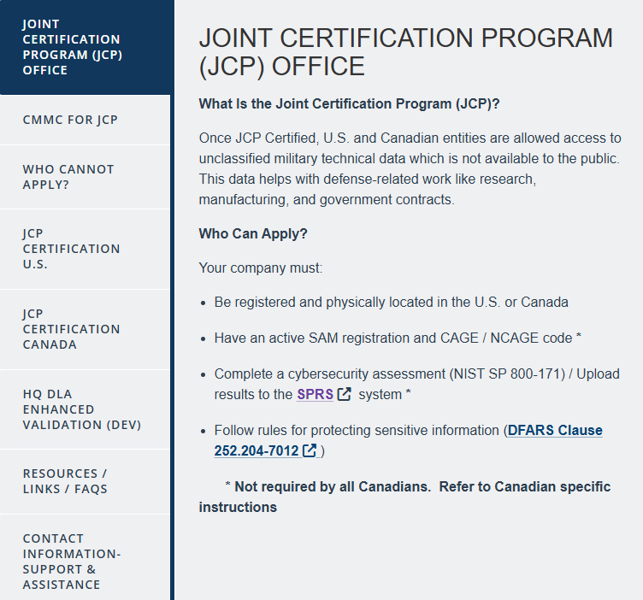
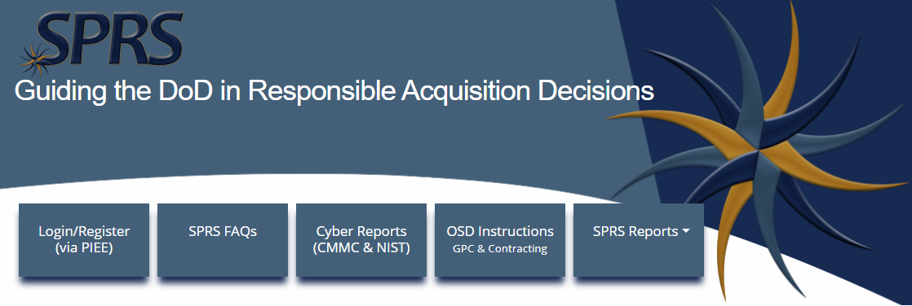

How To Obtain DD Form 2345
Apply through DLA’s Joint Certification Program (JCP) Office

Slide 18
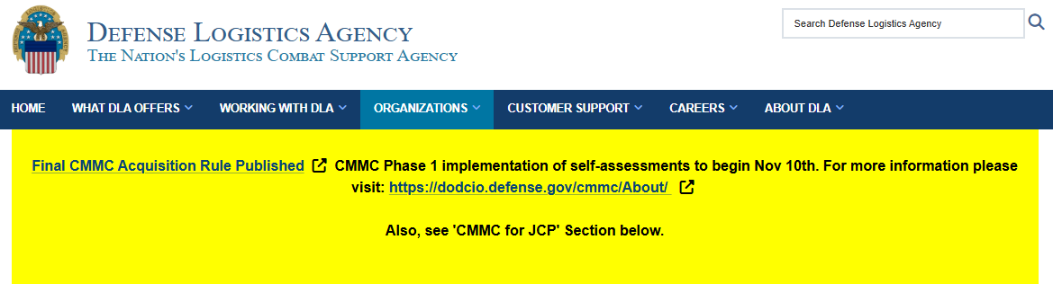
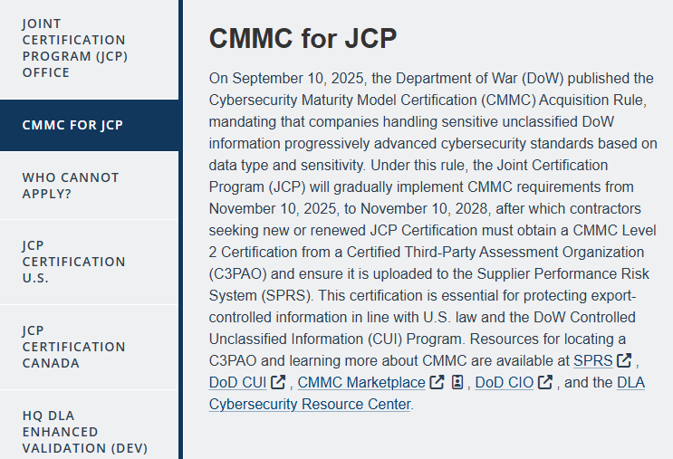
CMMC And The DD Form 2345
CMMC Level 2 (C3PAO) will be required after November 10, 2028 to obtain a DD Form 2345.

Slide 19
CMMC And CUI
If CMMC is included in the contract/agreement, you must verify the CMMC Status of your subcontractors and partners prior to sharing CUI with them on their systems.
Only the Government has access to SPRS to verify CMMC Status.
Organizations will need to share an export of their CMMC Status from SPRS. It will need to include:
CMMC Unique Identifier (UID)
CMMC Status (e.g. Level 2 – Self)
CAGE Codes covered by the assessment scope
Assessment, affirmation, and expiration dates

Slide 20
Resources Available To You
DoW CUI Program Website: https://www.dodcui.mil/
DoW CIO CMMC Website: https://dodcio.defense.gov/cmmc/About/
DLA JCP Website: https://www.dla.mil/logistics-operations/services/joint-certification-program/
ATI CMMC Resources: https://www.ati.org/cmmc-resources/
Contact your consortium team, PMOffice@ati.org, or cmmc.info@ati.org

Slide 21
Questions?
CMMC is Here
Pursuing CUI Contracts For The First Time
Want to discuss in more detail?
info@berylliuminfosec.com | cmmc.info@ati.org

