Slide 1



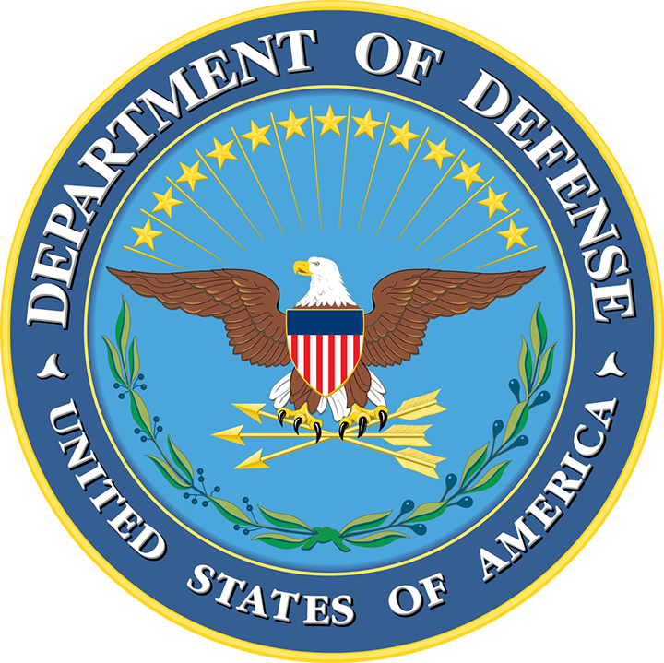
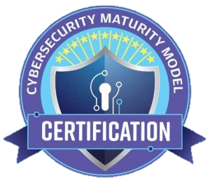


Understanding Flow-Down Requirements
What This Means for Your Business
Notes:
“Proprietary and Confidential?”

Slide 2
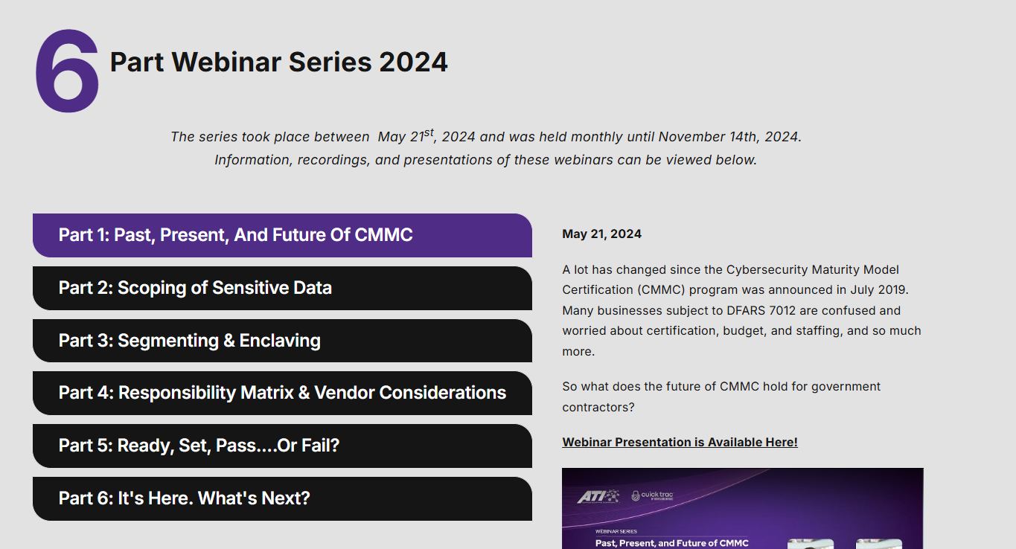
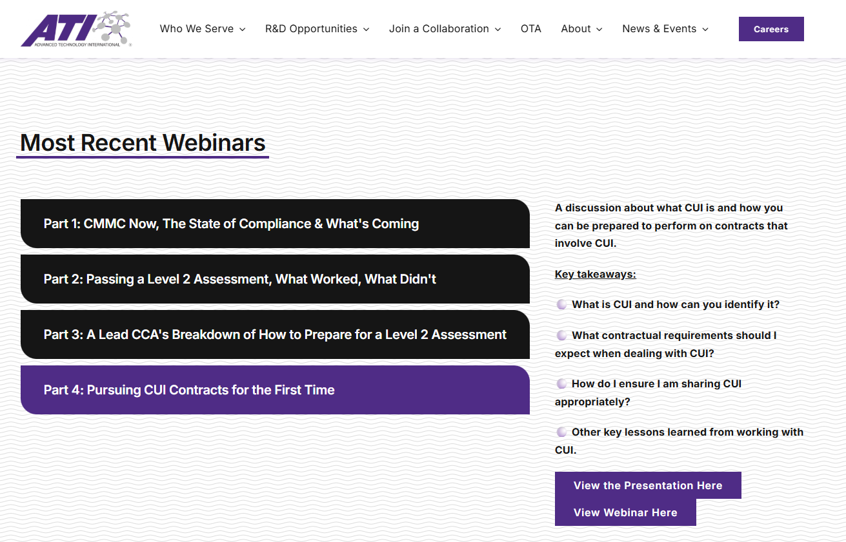

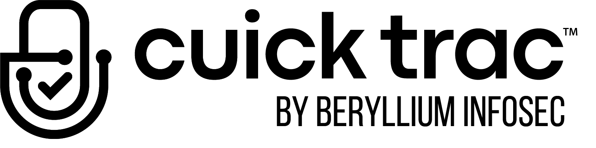

Agenda
https://www.ati.org/cmmc-resources/
Recap of Previous Webinar
Introductions
Flow-Down Breakdown
Common Confusion
What’s Happening Now
Q&A

Slide 3


Panelists
Derek White | Chief Operating Officer & Co-Founder
When Beryllium InfoSec was founded in 2018, Derek White and his team set out to help the Defense Supply Chain overcome resource constraints with practical, affordable cybersecurity solutions. Beryllium’s core product offering, the Cuick Trac Managed Enclave, solves that problem. Building on that mission, Derek brings deep expertise in CUI programs and compliance, guiding contractors through NIST SP 800-171, DFARS, and CMMC requirements. Together, they drive outcomes that make security achievable and sustainable across the Defense Industrial Base.
Koren Wise | Chief Executive Officer of Wise Technical Innovations
Koren is Lead Assessor and CEO of Wise Technical Innovations in Norfolk, VA. Wise Technical Innovations is a C3PAO and Authorized Training Provider for the DoW CMMC Program. She is the Vice Chair of the Cyber AB Accreditation Committee and serves on the CMMC Program Scheme & Certification Exam Appeals Committee Member. Koren specializes in building and assessing NIST-aligned cybersecurity programs, including CMMC, risk and vulnerability assessments, incident response, and business continuity. With over 23 years as a Network and Security Architect, Koren brings deep expertise in risk-based approaches, compliance readiness, and helping organizations meet regulatory and business objectives. She is CISSP and PMP certified.

Slide 4

Flow-Down: What the Regulations Say
What does Title 32 / Part 170 tell us about flow-down?
What does DFARS tell us about flow-down?
How does the DoW ensure the data is protected throughout the entire supply-chain?

Slide 5
DFARS Cyber Clauses & Flow-Down
Foundational cybersecurity, incident response and reporting obligations tied to NIST SP 800-171, FedRAMP Moderate requirements for CSPs, access to systems and logs for investigations, malicious software submission
252.204-7012
252.204-7025 / 252.204-7021
Introduces assessment requirements at each level and reporting expectations (SPRS visibility) for contract award eligibility and throughout the life of the contract
252.204-7021
CMMC Program integration and certification direction
252.204-7997
Allowing access to DoD Assessment Teams (DIBCAC)
(Previously 252.204-7020)

Slide 6
Understanding Current Regulations | DFARS 252.204-7012
Adequate Security Measures
Cyber Incident Reporting
Malicious Software Submissions
Media Preservation and Protection
Access to Affected Systems
Flow Down to Subcontractors
FedRAMP Moderate Baseline for CSPs

Slide 7
NIST 800-171 Assessments Are Happening Now
Type | Performed by | Supporting DFARS Clause/Provision | Status
Self-Assessment | DIB Company or Organization | Title 32 Part 170 48 CFR, 252.204-7025 and 252.204-7021 | Required Now
DIBCAC Medium (SSP Examination) | DCMA/DIBCAC Team | 252.204-7012, 252.204-7997 | Active / Not Voluntary
DIBCAC High (On-Site visit) | DCMA/DIBCAC Team | 252.204-7012, 252.204-7997 | Active / Not Voluntary
CMMC | C3PAO | Title 32 Part 170 48 CFR, 252.204-7025 and 252.204-7021 | Active / Voluntary / and soon to be required on many contracts in year 2 of 48 CFR being final

Slide 8
Common Areas of Confusion
Assuming DFARS cyber clauses only apply to primes, when many are explicitly required to flow down
Confusing yearly “affirmations” and triennial “assessment” requirements

Slide 9
CMMC Assessment Requirement Breakdown
CMMC Level & Assessment Type | Who Performs Assessment? | Assessment Frequency / Validity Period | POAM / Conditional Allowed? | Minimum Score for SPRS / Award
Level 1 (Self) | Contractor (Self) | Annually (Must be current at award/option/extension; not older than 1 year) | No (Final status only) | 15/15 (100%) – All requirements MET; no POA&M allowed. Any NOT MET = ineligible
Level 2 (Self) | Contractor (Self) | Every 3 years (Must be current at award/option/extension; not older than 3 year) | Yes (Conditional allowed for up to 180 days with POA&M) | 88/110 (80%) for conditional status (POA&M 180 day max) – 110/110 (100%) for Final status
Level 2 (C3PAO) | Third-Party (C3PAO) | Every 3 years (Must be current at award/option/extension; not older than 3 year) | Yes (Conditional allowed for up to 180 days with POA&M) | 88/110 (80%) for conditional status (POA&M 180 day max) – 110/110 (100%) for Final status
Level 3 (DIBCAC) | Dow/DoD (DIBCAC) | Every 3 years (Must be current at award/option/extension; not older than 3 year) | Yes (Conditional allowed for up to 180 days with POA&M) | 80% of Level 3 controls for conditional status (POA&M 180 day max) –100% of Level 3 controls for Final status. Must have perfect Level 2 (C3PAO) score to initiate

Slide 10
Compliance Impact
Minimum score requirements for CMMC SPRS results that will be specified in provision 252.204-7025
Underestimating the scope of compliance
(e.g., NIST SP 800-171 alignment under 7012 and 7021)

Slide 11
Questions?
Want to discuss in more detail?
info@berylliuminfosec.com | cmmc.info@ati.org

