Slide 1




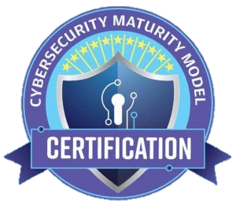


CMMC Now
The State of Compliance & What’s Coming
Notes:
“Proprietary and Confidential?”

Slide 2




Panelists
Derek White | Chief Operating Officer & Co-Founder
When Beryllium InfoSec was founded in 2018, Derek White and his team set out to help the Defense Supply Chain overcome resource constraints with practical, affordable cybersecurity solutions. Beryllium’s core product offering, the Cuick Trac Managed Enclave, solves that problem. Building on that mission, Derek brings deep expertise in CUI programs and compliance, guiding contractors through NIST SP 800-171, DFARS, and CMMC requirements. Together, they drive outcomes that make security achievable and sustainable across the Defense Industrial Base.
George Perezdiaz | Director of Advisory Services
George is a cybersecurity leader with over 20 years of experience in IT Risk and Compliance management, specializing in protecting U.S. government-regulated data, including covered federal information, controlled unclassified information, and export-controlled information. A US Air Force veteran and Lead CMMC Certified Assessor, he has built, managed, and maintained effective compliance programs across diverse sectors. He has dedicated his career to empowering teams and advancing trusted security practices.

Slide 3
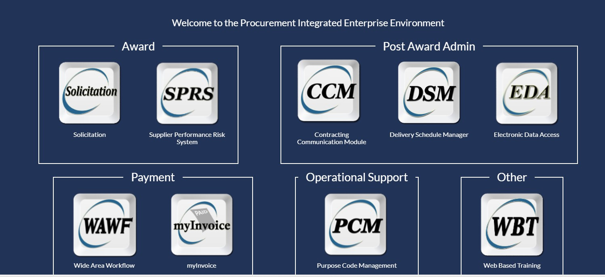
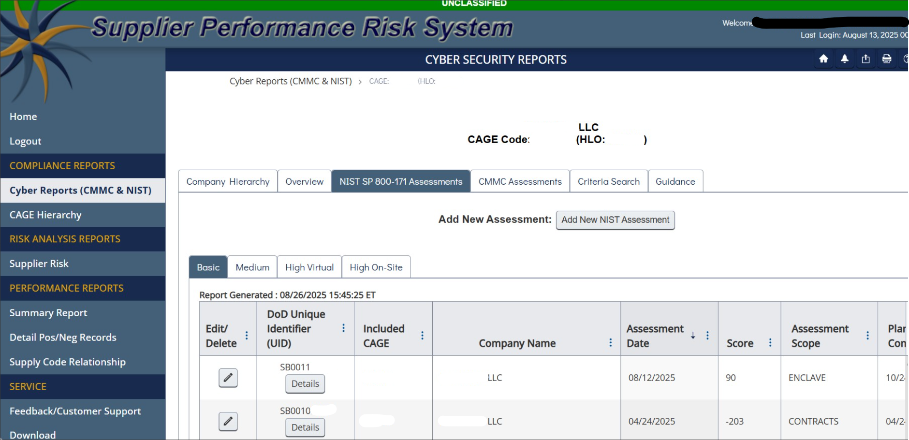
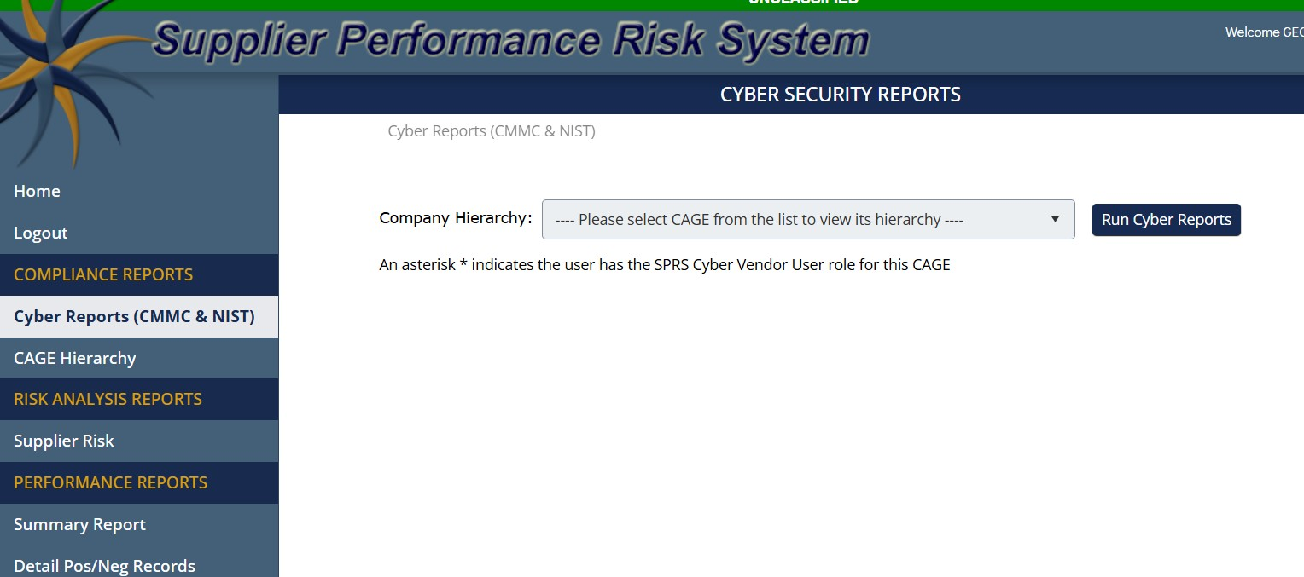
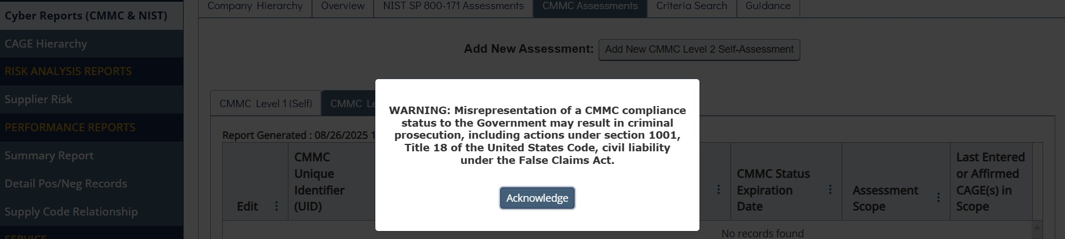
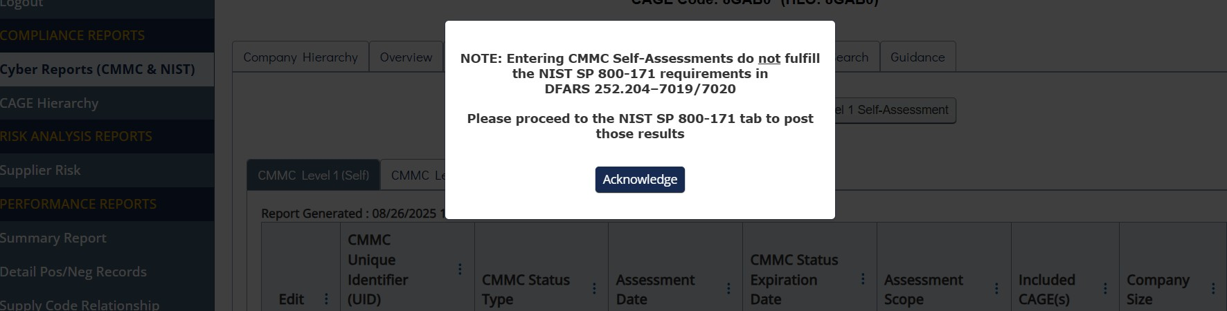
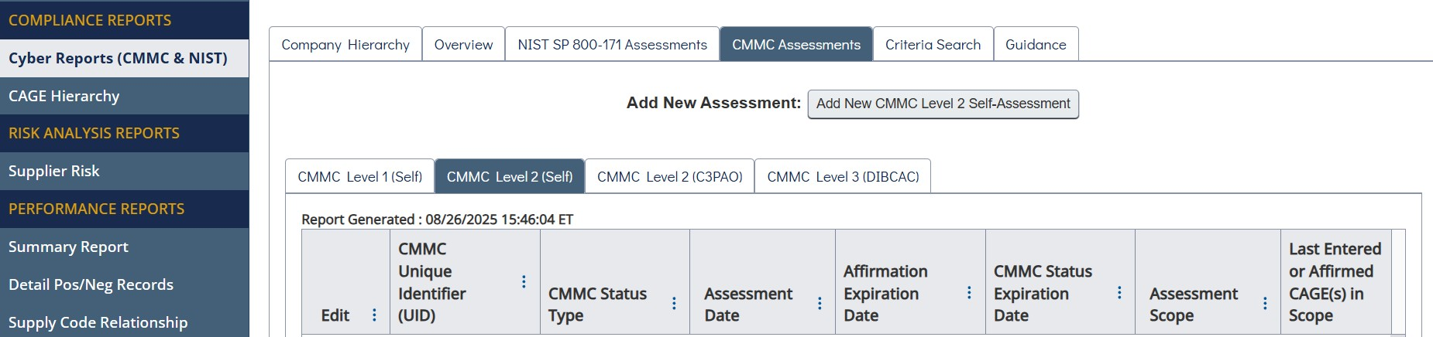
Current CMMC Landscape
32 CFR Part 170 – Effective as of Dec 2024
Statutory Requirement (10 U.S.C. § 4811)
Regulatory Requirement (32 CFR Part 170)
Contract clause requiring validation of the security requirements (NIST 800-171/171A):
  Likely DFARS 252.204-7021
Changes (adds to) DFARS 252.204-7012 and 7020
  From: “Trust Us – We’ve implemented NIST SP 800-171”
  To: “Trust and Verified – We have been assessed by a C3PAO or Affirmed by our Leadership”
  And now: Failure to comply could lead to False Claims Act liability or contract loss

Slide 4
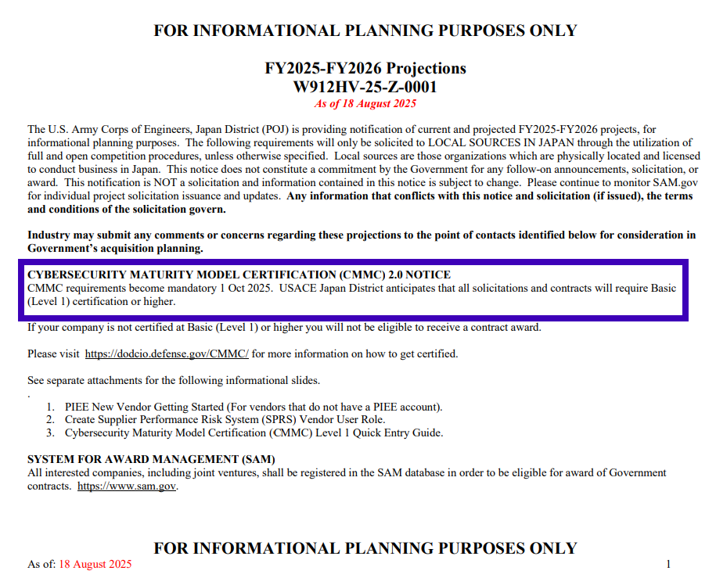
Current CMMC Landscape
48 CFR – CMMC Acquisition Rule (DFARS – 7021)
Timeline: Unknown…but
July 2025: With OIRA for final review
Expected final and effective Oct 2025 – Feb 2026
CMMC requirements can be included in contracts before the rule becomes final, requiring bilateral modification post-negotiation.
https://sam.gov/workspace/contract/opp/3ce4a46191a24841b8cf37bdcfdc49e0/view

Slide 5

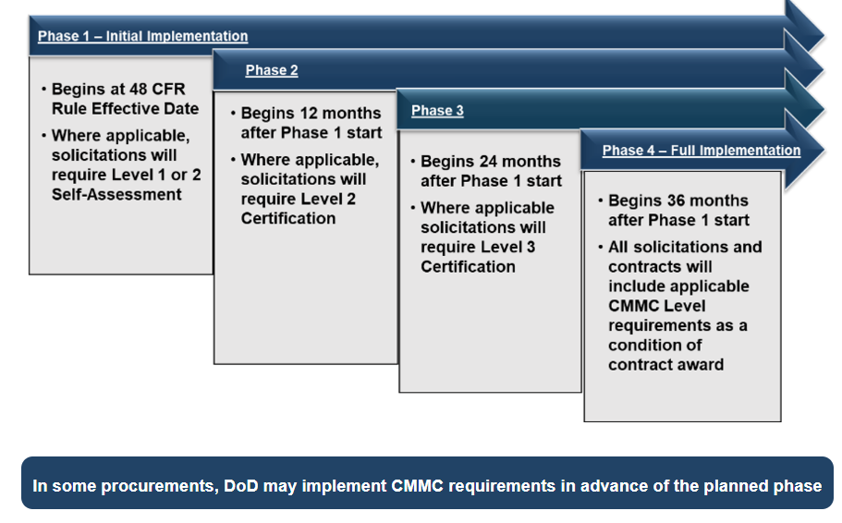
Current CMMC Landscape
Phased-IN Implementation Plan
We are (almost) here
Important to note:
“Self-Assessment” vs C3PAO

Slide 6
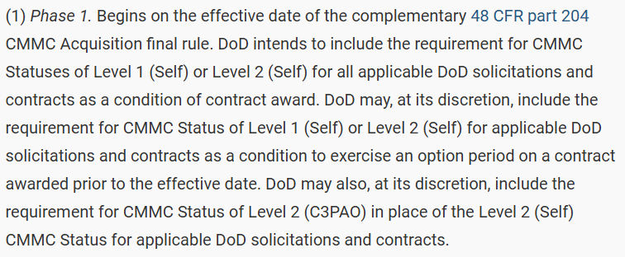
Current CMMC Landscape
32 CFR Needs the Complementary 48 CFR
Once Final and Effective – Contracts will require CMMC Level 1 and/or Level 2
CMMC requirements will be implemented using a 4-phase implementation plan over a three-year period.

Slide 7
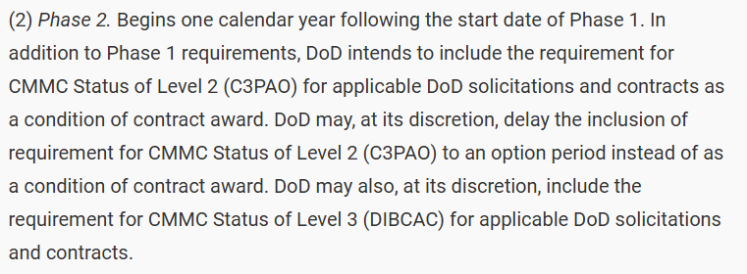
Current CMMC Landscape
32 CFR Needs the Complementary 48 CFR
Once Final and Effective – Contracts will require CMMC Level 1 and/or Level 2
CMMC requirements will be implemented using a 4-phase implementation plan over a three-year period.

Slide 8
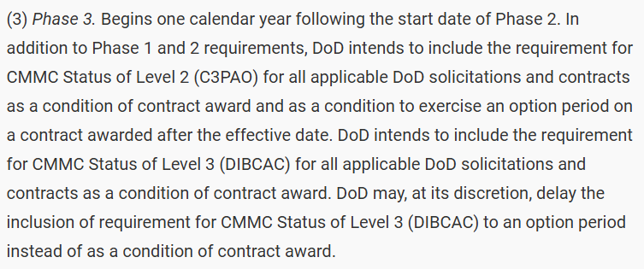
Current CMMC Landscape
32 CFR Needs the Complementary 48 CFR
Once Final and Effective – Contracts will require CMMC Level 1 and/or Level 2
CMMC requirements will be implemented using a 4-phase implementation plan over a three-year period.

Slide 9
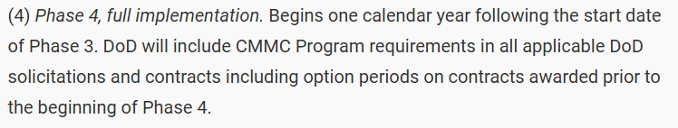
Current CMMC Landscape
32 CFR Needs the Complementary 48 CFR
Once Final and Effective – Contracts will require CMMC Level 1 and/or Level 2
CMMC requirements will be implemented using a 4-phase implementation plan over a three-year period.

Slide 10
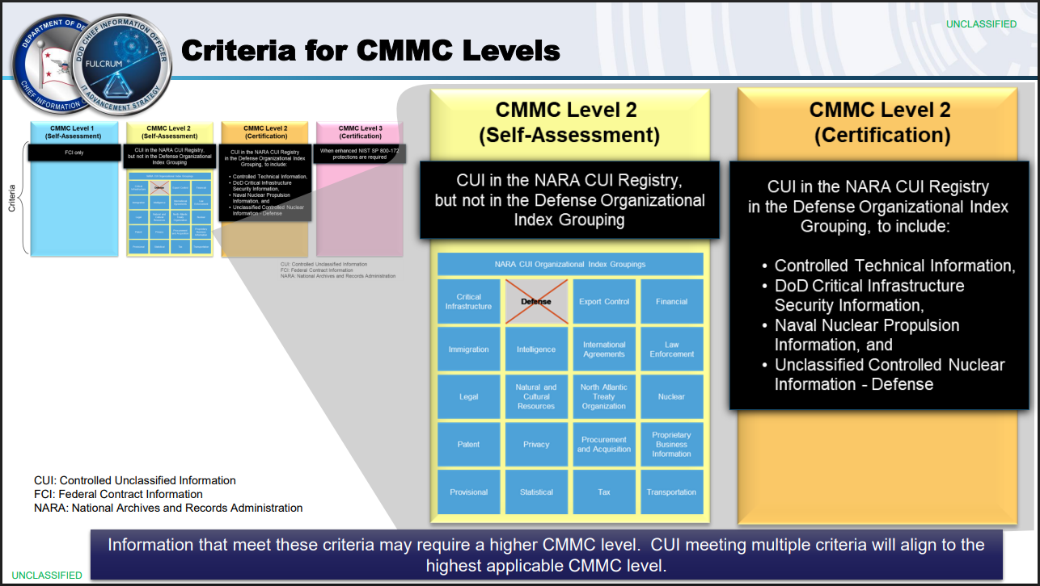
Current CMMC Landscape
Phased-IN Implementation Plan
https://dodcio.defense.gov/Portals/0/Documents/CMMC/CMMC-LevelsDeterminationBrief.pdf

Slide 11
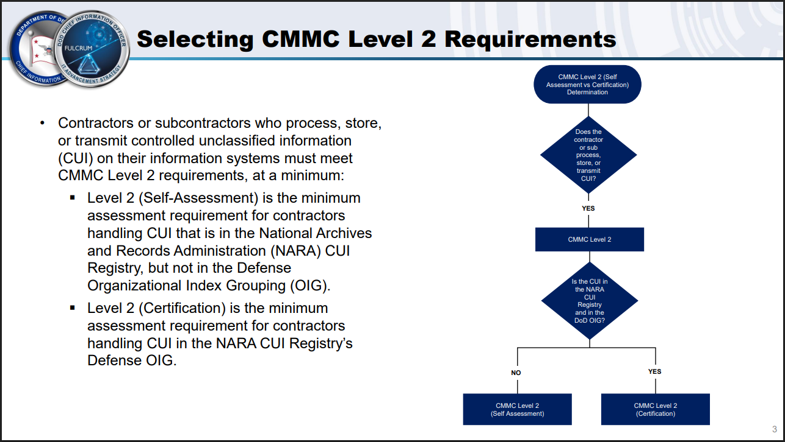
Current CMMC Landscape
Phased-IN Implementation Plan
https://dodcio.defense.gov/Portals/0/Documents/CMMC/CMMC-LevelsDeterminationBrief.pdf

Slide 12

CMMC Level 2 Assessments Exist TODAY
Lessons Learned Thus Far:
  Scope / Assessment Boundary
  Documentation, Documentation, Documentation
  C3PAO Selection Process
  CMMC Assessment Process

Slide 13

CMMC Level 2 Assessments Exist TODAY
Next Steps:
  Identify the CUI your organization has
    CUI Basic vs. Specified
  Security and Compliance Documentation
    Re-review, validate, improve
  Perform a Mock / Readiness Assessment
    If possible, use an Independent Assessor/C3PAO
  Interview many C3PAOs
    Look beyond the C3PAO and into the Lead Assessor Role

Slide 14
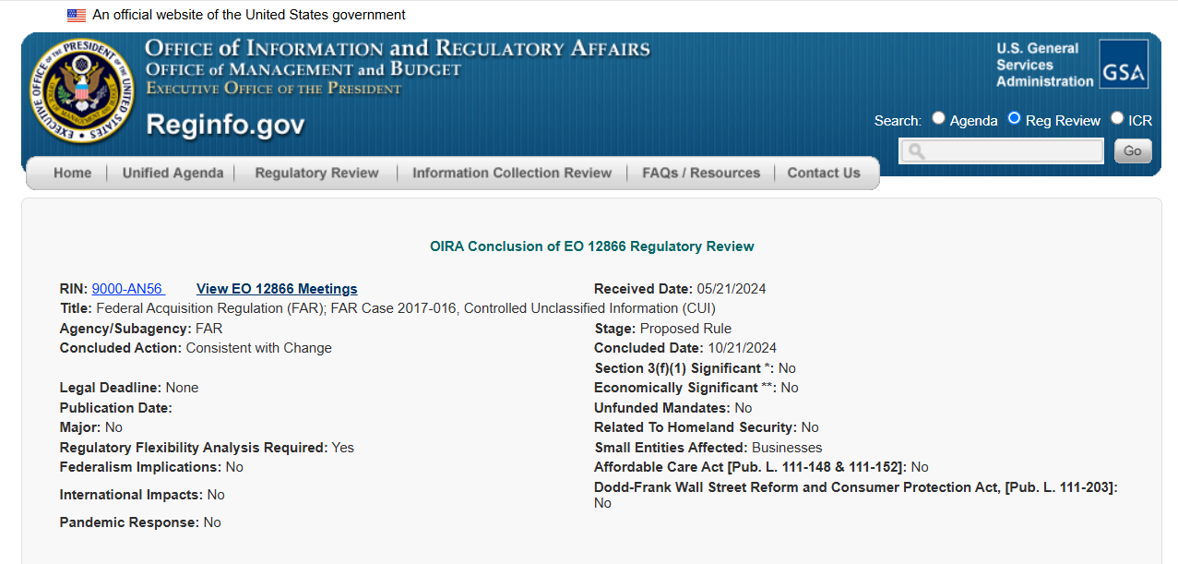
Other Points to Watch
FAR CUI Rule

Slide 15
Questions?
CMMC Now
The State of Compliance & What’s Coming
Want to discuss in more detail?
info@berylliuminfosec.com | cmmc.info@ati.org

