Slide 1




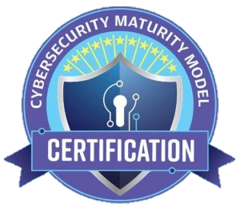


CMMC Now
Passing a Level 2 Assessment: What Worked, What Didn’t
Notes:
“Proprietary and Confidential?”

Slide 2

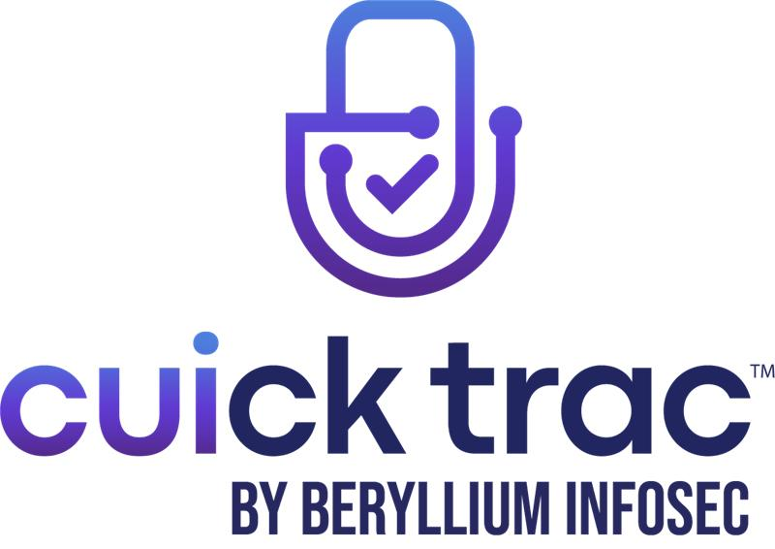





Panelists
Derek White | Chief Operating Officer & Co-Founder
When Beryllium InfoSec was founded in 2018, Derek White and his team set out to help the Defense Supply Chain overcome resource constraints with practical, affordable cybersecurity solutions. Beryllium’s core product offering, the Cuick Trac Managed Enclave, solves that problem. Building on that mission, Derek brings deep expertise in CUI programs and compliance, guiding contractors through NIST SP 800-171, DFARS, and CMMC requirements. Together, they drive outcomes that make security achievable and sustainable across the Defense Industrial Base.
Katie Dodson | President
Katie is a cybersecurity leader with over a decade of experience in risk management, compliance, and cyber threat intelligence across both public and private sectors. She has worked with Fortune 500 companies as well as the Department of Defense, including the Air Force, HHS, and the Defense Cyber Crime Center. A CISSP and Lead CMMC Certified Assessor (CCA), she specializes in safeguarding defense contractor network and government data through effective security controls and compliance programs. Katie is dedicated to helping organizations navigate complex cyber risks with confidence.

Slide 3

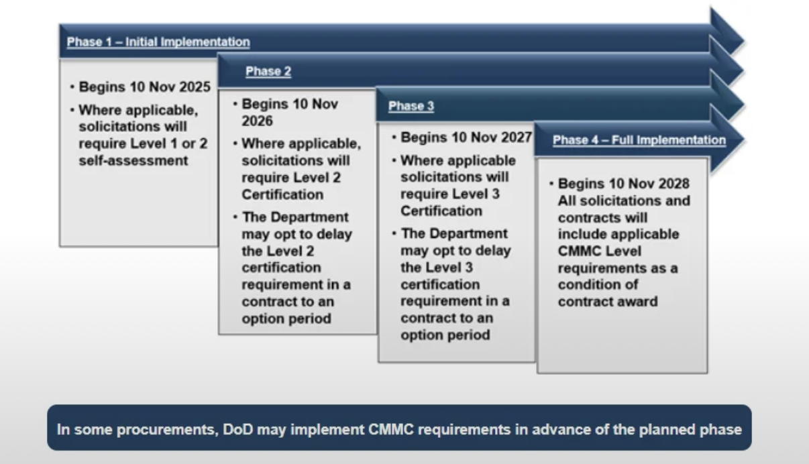
Current CMMC Timeline
Recap: Phase-IN Implementation Plan
We are (almost) here
Important to note:
“Self-Assessment” vs C3PAO

Slide 4

CMMC Level 2 Assessments: FAQs
  How long does a typical level 2 assessment take from start to finish?
  What kind of evidence do assessors expect to see?
  How much weight is given to documentation vs. actual technical implementation?
  What happens if a company isn’t fully compliant during the assessment?
  How much does an assessment cost?
  What is the actual process of conducting a Level 2 assessment like?

Slide 5

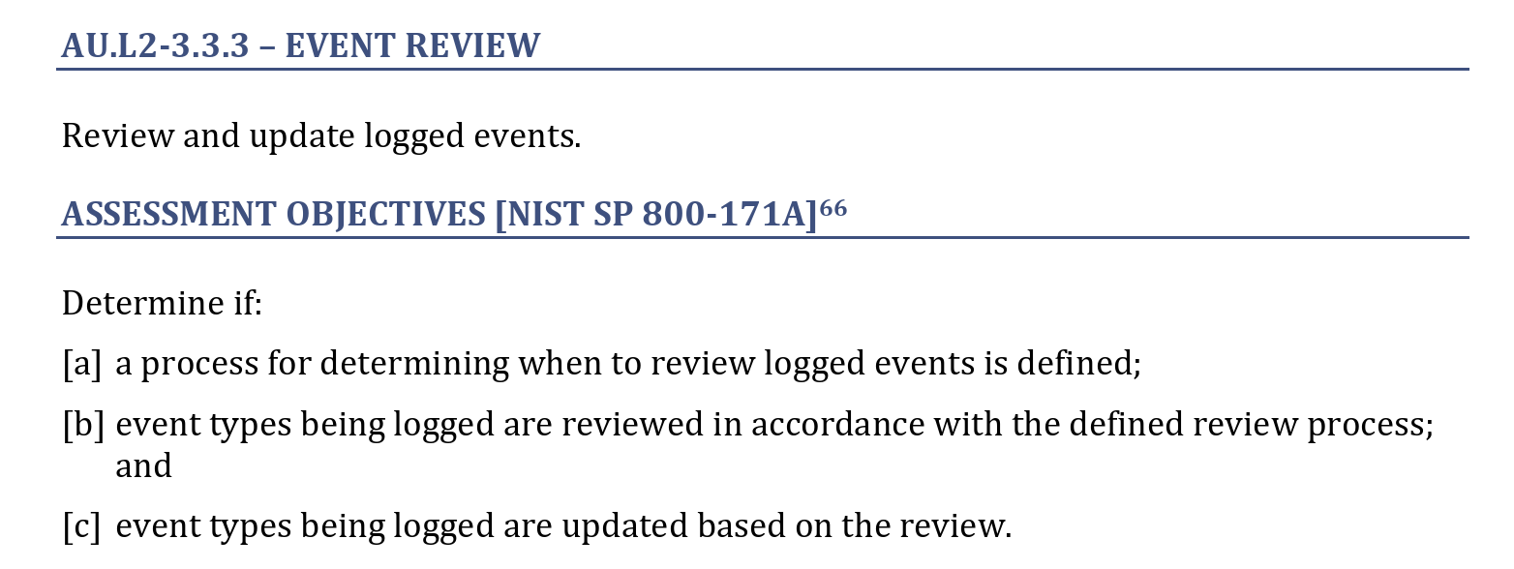
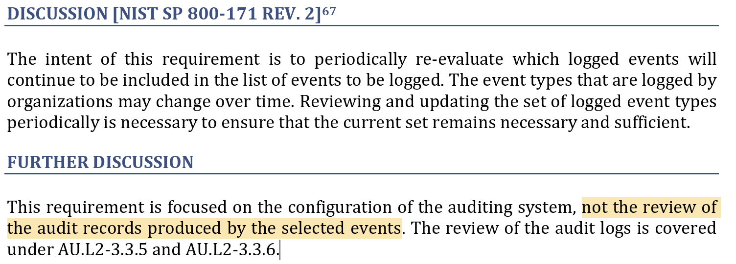
CMMC Level 2 Assessments: Lessons Learned
  What are the most common gaps or shortcomings you’ve observed during assessments?
  What are examples of pitfalls that organizations consistently underestimate?
  What do successful, well-prepared organizations typically have in common?
  What works, and what doesn’t?

Slide 6

CMMC Level 2 Assessments: Looking Ahead
  How do you see CMMC evolving over the next few years?
  What advice would you give to organizations that are just starting their CMMC journey?
  If you could give companies one piece of advice to avoid stress during the assessment, what would it be?

Slide 7
Questions?
CMMC Now
Passing a Level 2 Assessment: What Worked, and What Didn’t
Want to discuss in more detail?
info@berylliuminfosec.com | cmmc.info@ati.org

